Slide 1
Multiple Linear Regression
LECTURE 15.5
Introducing a more nuanced model.
Sean Kang

Slide 2
Recap Simple linear regression

Slide 3
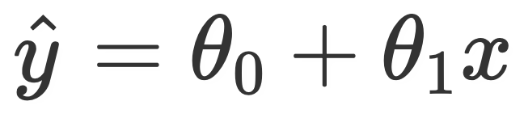
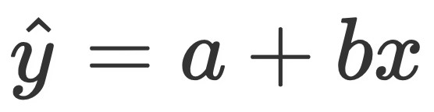
Equation of the regression line
A simple linear model (with a slope and intercept) is of the form
Note, we have two parameters now. For simplicity’s sake, we will instead say (for now): (lab)
We call this the simple linear regression model.
Notes:
Look at slope and intercept function in lab

Slide 4
RMSE and Multiple R²

Slide 5
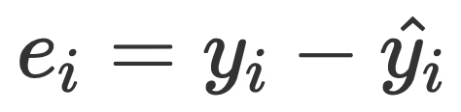
Evaluating models
What are some ways to determine if our model was a good fit to our data?
Look at MSE or RMSE.
Look at the correlations.
Look at a residual plot.
Residuals are defined as being the difference between actual and predicted y values.
.
Next lecture!
Notes:
This is new terminology.

Slide 6
Multiple linear regression
MLR is an extension of Simple Linear Regression.

Slide 7
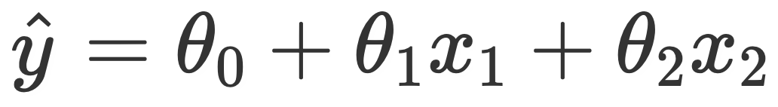
Adding independent variables
Estimated multiple regression model with two features (and thus, three parameters), is of the form

Slide 8
Adding More Independent Variables
Adding more variables does not always mean a better fitting model.
Does not always make predictions better
More variables can explain more variations
The best way:
Pick the best input variables for the model
Problems:
Overfitting – add variance, or can explain for variation in output but does not add much prediction to the model.
Multicollinearity – independent variables are dependent on each other, not just the output variable

Slide 9
Idea Example
Bad Example
Housing Price – the output dependent variable
Input Independent Variables
Age of house
Square foot space of the house
Ratings of the high school
Great view from backyard
Interior Renovations
Housing Price – the output dependent variable
Input Independent Variables
Num of bed and bath
Square foot space of the house
Master bedroom on main floor

Slide 10
Prep Work
Correlations
Scatter Plots
Simple Regressions

Slide 11
Let’s Start
Dependent Variable: Housing Price (Estimated)
Independent Variable:
Square Foot of the living space
Ratings of the High School
Sq Ft
(x₁)
Price
School Rating (x2)

Slide 12
If you add more variables
The number of potential collinearity relationships between the independent variables exists and must be analyzed.
Some independent variables are better than others
Some have no contribution to the dependent variable

Slide 13
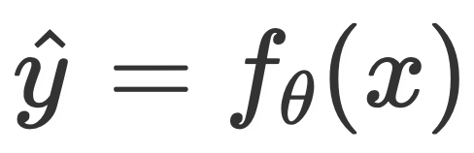
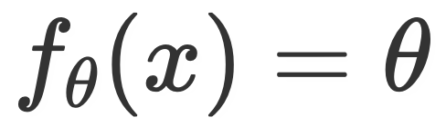
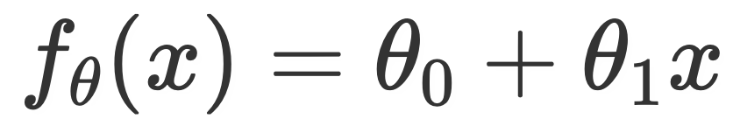

General notation
Our models can be expressed as a function of an input variable, x.
Constant model:
Simple linear regression model:
Multiple linear regression model:
Intercept
Variables
Coefficients

Slide 14
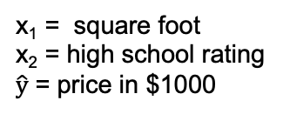
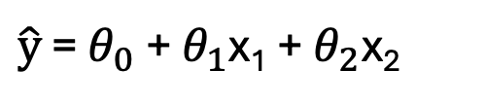
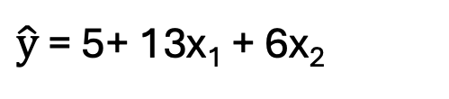
Interpretation
$\hat{\text{y}}$ = $θ_{0}$ + $θ_{1}$x₁ + $θ_{2}$x₂
x₁ = square foot
x₂ = high school rating
$\hat{\text{y}}$ = price in $1000
$\hat{\text{y}}$ = 5+ 13x₁ + 6x₂
1 square foot of space would translate to 13k towards the price of the house, keeping the school rating constant.
If the high school rating is an ordinal from 1-10 where 10 is the best and 1 is the lowest, a school rating of 1 would only contribute 6k towards the price of the house.

Slide 15
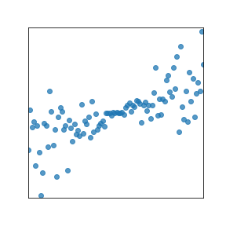
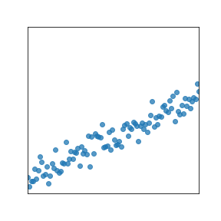
Some Scatter Plots of IV to DV
Price
Price
School Rating
Square Foot
Both square footage and school ratings have a highly correlated to Price.

Slide 16
Some Scatter Plots of IV to IV
Square Foot
School Rating
These two IV have a visual correlation relationship. We will just note that for now. We can calculate the actual correlation coefficient in the lab.

Slide 17
Multiple Linear Regression
Involves the SLR of each IV (using prior lecture notes)
More to come
Overfitting analysis

Slide 18
Summary

Slide 19
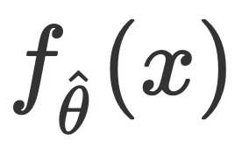
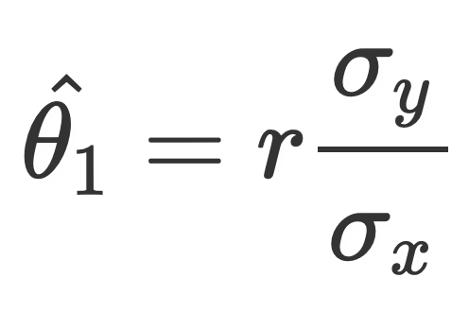
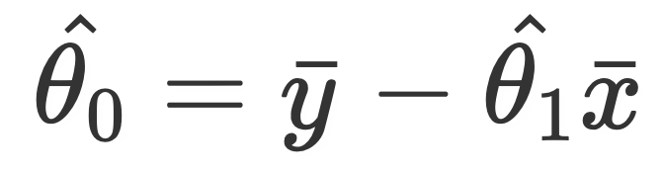
Summary
We now know of three models, .
The constant model, .
The simple linear regression model .
The multiple linear regression model .
A model with optimal parameters is denoted .
We looked at the correlation coefficient, r, and studied its properties.
We solved for the optimal parameters for the simple linear model by hand, by minimizing average squared loss (MSE) or algebra in lecture 15.

